Slide 1

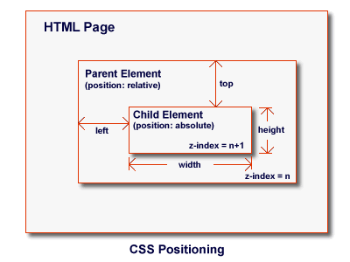


CSS Positioning
CSS Positioning and Floating
CSS Positioning
SoftUni Team
Technical Trainers
Software University
http://softuni.bg

Slide 2
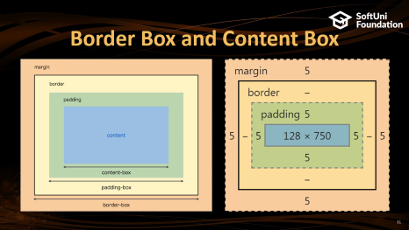
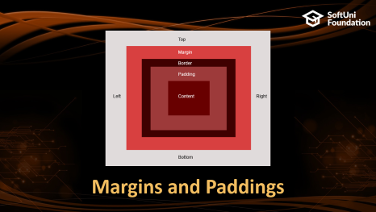
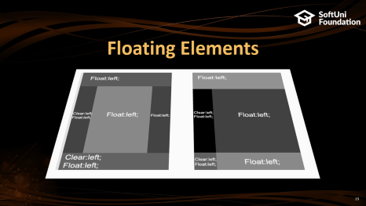
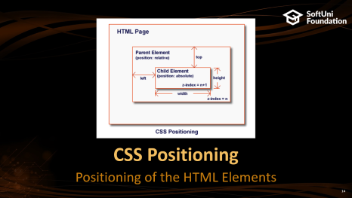
Table of Contents

Slide 3
Have a Question?
sli.do #front-end

Slide 4
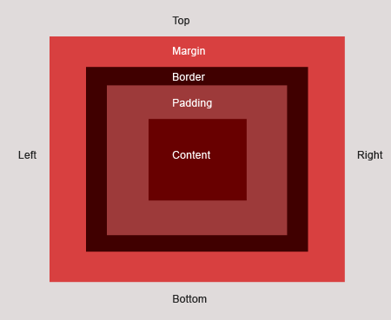
Margins and Paddings

Slide 5
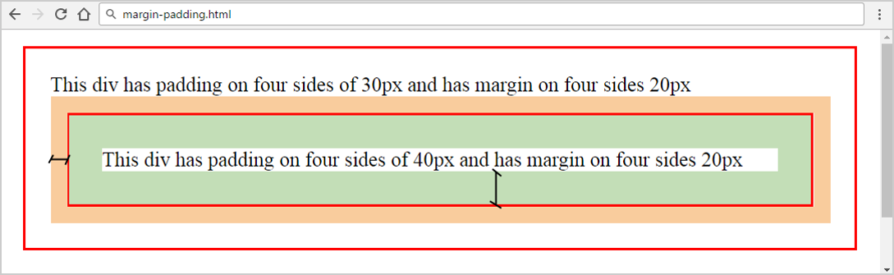
Margins and Paddings
margin
padding
margin-top
margin-right
margin-bottom
div { margin: 20px 20px 20px 20px;
padding: 30px 30px 30px 30px; }
margin-left

Slide 6
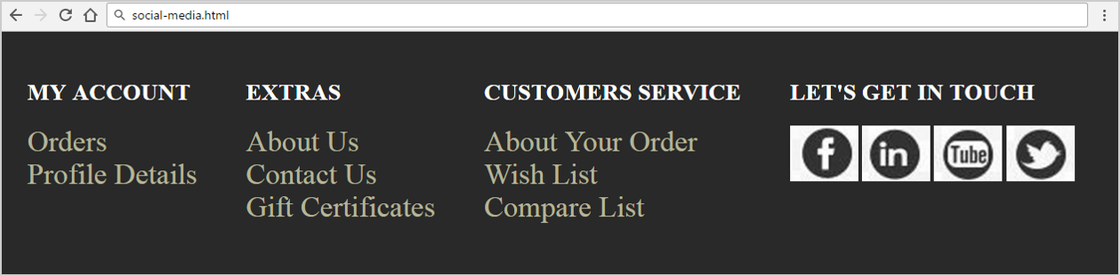
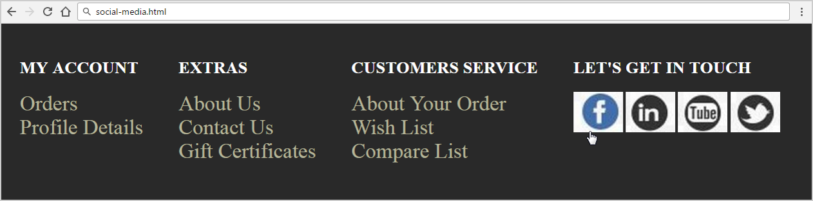
Problem: Social Media

Slide 7
Solution: Social Media – HTML
<footer>
<section>
<h2>my account</h2>
<ul>
<li><a href="#">orders</a></li>
<li><a href="#">profile details</a></li>
</ul>
</section>
<!-- TODO: put the rest <section> here -->
<!-- TODO: put the rest <ul> here -->
<!-- TODO: put the rest <li> here -->

Slide 8
Solution: Social Media – HTML (2)
<section>
<h2>let's get in touch</h2>
<div>
<div class="facebook"><a href="#"></a></div>
<div class="linkedin"><a href="#"></a></div>
<div class="youtube"><a href="#"></a></div>
<div class="twitter"><a href="#"></a></div>
</div>
</section>
</footer>
Check your solution here: https://judge.softuni.bg/Contests/406/

Slide 9
Solution: Social Media – CSS
ul, li, div, section, a {
margin: 0;
padding: 0; }
body {
background: rgb(41, 41, 41); }
footer {
height: 150px;
margin: 0 auto; }
h2 {
text-transform: uppercase; }
section {
float: left;
margin-left: 10px;
padding: 20px;
height: 150px;
color: #ffffff;
}
ul {
list-style: none;
}
a {
text-decoration: none;
color: rgb(181, 180, 152);
font-size: 30px;
text-transform: capitalize;
}

Slide 10
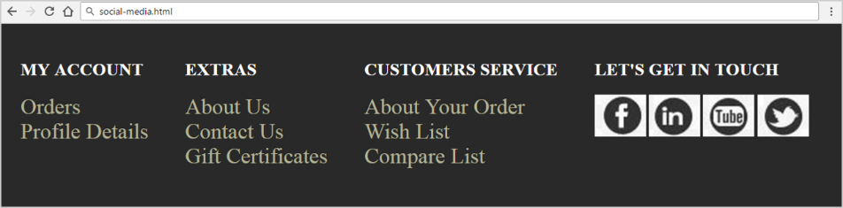
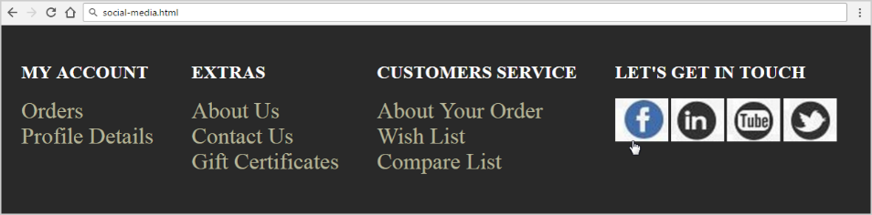
Solution: Social Media – CSS (2)
footer > section > div div {
width: 70px;
height: 58px;
background: url("images/social.jpg");
display: inline-block; }
.twitter { background-position: 772px 126px; }
.linkedin { background-position: 642px 126px; }
.youtube { background-position: 325px 126px; }
.facebook, .twitter, .youtube, .linkedin { cursor: pointer; }
.facebook:hover { background-position: 0 60px; }
.linkedin:hover { background-position: 642px 63px; }
.youtube:hover { background-position: 325px 63px; }
.twitter:hover { background-position: -66px 63px; }

Slide 11
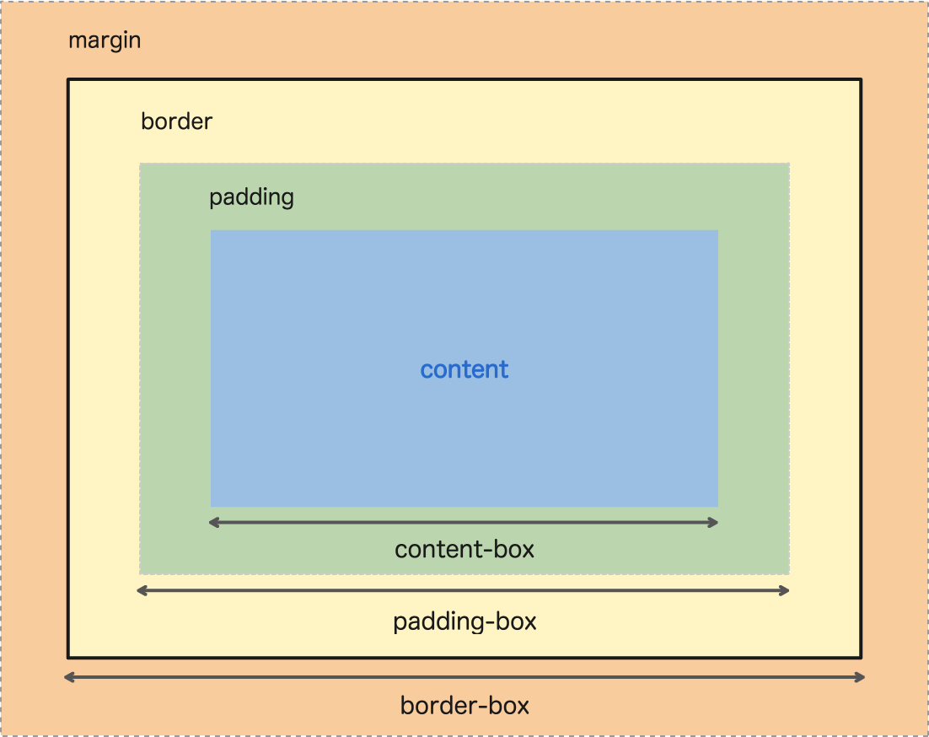
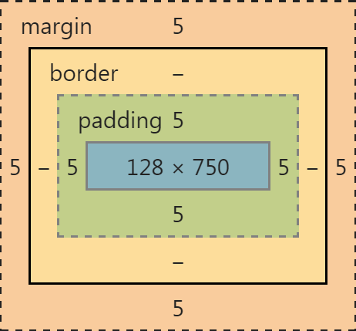
Border Box and Content Box

Slide 12
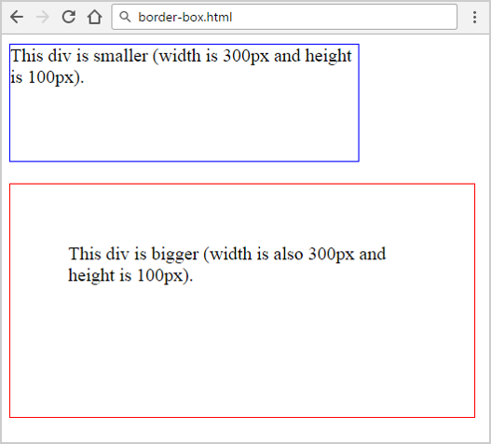
CSS Box-Sizing: Content-Box
<div class="div1">This div is smaller…</div>
<div class="div2">This div is bigger…</div>
.div1 {
width: 300px;
height: 100px;
border: 1px solid blue; }
.div2 {
width: 300px;
height: 100px;
padding: 50px;
border: 1px solid blue;
}

Slide 13
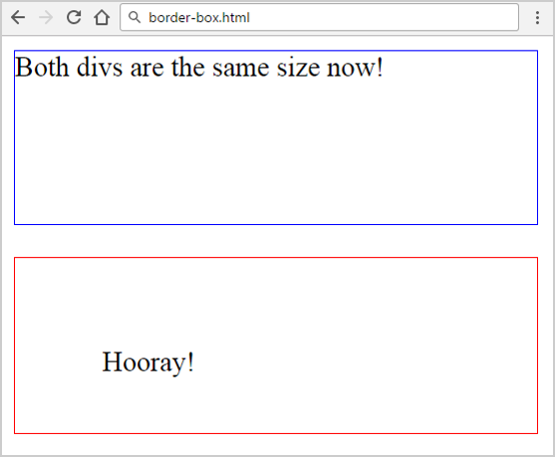
CSS Box-Sizing: Border-Box
<div class="div1">Both divs…</div>
<div class="div2">Hooray!</div>
* { box-sizing: border-box; }
.div1 {
width: 300px;
height: 100px;
border: 1px solid blue; }
.div2 {
width: 300px;
height: 100px;
padding: 50px;
border: 1px solid blue; }

Slide 14
CSS Positioning
Positioning of the HTML Elements

Slide 15
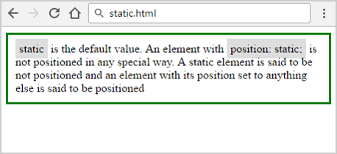
Positioning: Static
<div class="static">
static is the default value…
</div>
.static {
position: static;
border: 3px solid green;
padding: 10px;
}

Slide 16
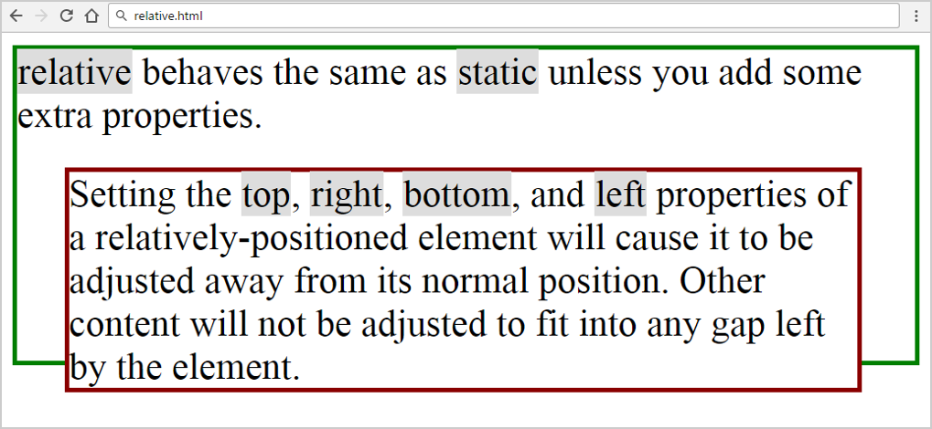
Positioning: Relative
<div class="relative1">
relative behaves …
<div class="relative2">
Setting the top…
</div>
</div>
.relative1 {
position: relative;
}
.relative2 {
position: relative;
top: 20px; left: 30px; }

Slide 17
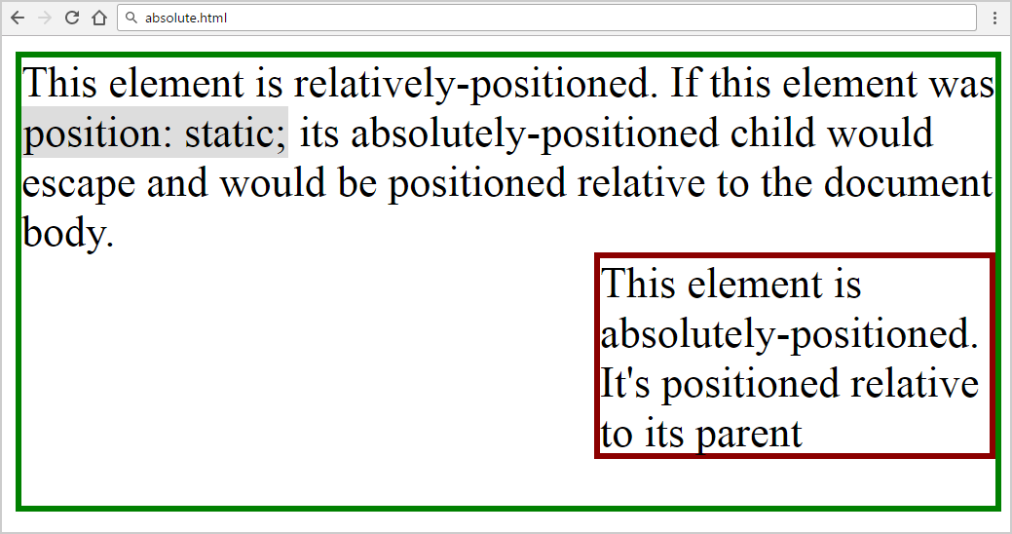
Positioning: Absolute
<div class="relative">
This element is relatively…
<div class="absolute">
This element is…
</div>
</div>
.relative {
position: relative;
}
.absolute {
position: absolute;
top: 100px; right: 0; }

Slide 18
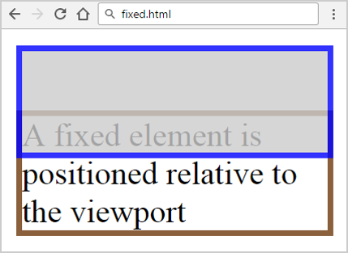
Positioning: Fixed
.fixed {
position: fixed;
top: 40px;
background: white;
width: 150px;
border: 3px solid #8b603d; }
.div {
background: #CCCCCC;
opacity: 0.8;
width: 150px;
height: 50px;
border: 3px solid #0000FF; }
<div class="fixed">
A fixed element is positioned
</div>
<div class="div"></div>

Slide 19
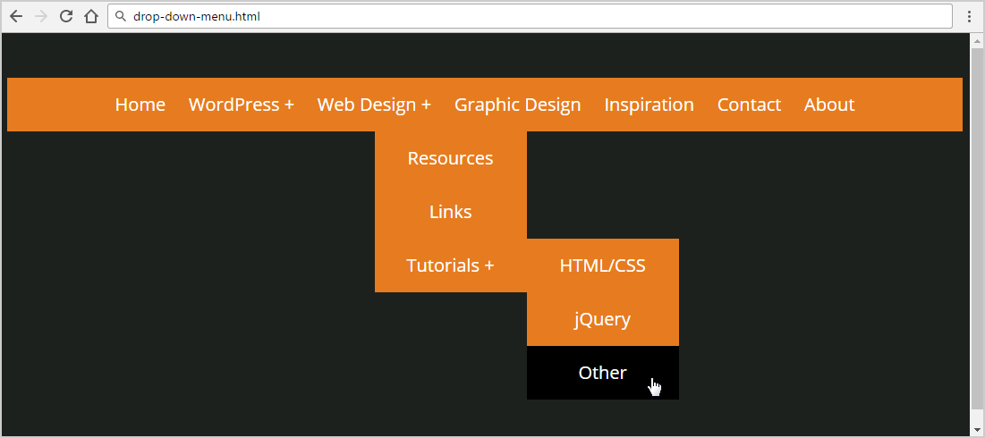
Problem: Drop Down Menu
Create a Web page (HTML + CSS) like at the screenshot:
Check your solution here: https://judge.softuni.bg/Contests/406/

Slide 20
Solution: Drop Down Menu (HTML)
<nav>
<ul>
<li><a href="#">Home</a></li>
<!-- TODO: put the rest list item here-->
<li><a href="#">Web Design</a>
<ul>
<!-- TODO: put the rest list item here-->
<li><a href="#">Tutorials</a>
<ul><!-- TODO: put the rest list item here--></ul>
</li>
</ul>
</li><!-- TODO: put the rest list item here-->
</ul>
</nav>

Slide 21
Solution: Drop Down Menu (CSS)
@import url(http://fonts.googleapis.com/css?family=Open+Sans);
body {
font-family: 'Open Sans', sans-serif;
background: #1d211e;
font-size: 22px;
line-height: 22px;
color: #ffffff;
text-align: center; }
a {
color: #ffffff; }
nav {
margin: 50px 0;
background-color: #e67c1f; }
nav ul {
padding: 0;
margin: 0;
list-style: none;
position: relative;
}
nav ul li {
display: inline-block;
background-color: #e67c1f;
}

Slide 22
Solution: Drop Down Menu (More CSS)
nav a {
display: block;
padding: 0 10px;
color: #FFF;
font-size:20px;
line-height: 60px;
text-decoration: none; }
nav a:hover {
background-color: #000000;
}
nav ul ul {
display: none;
position: absolute; }
nav ul li:hover > ul {
display: inline-block; }
nav ul ul li {
width: 170px;
position: relative;
display: block; }
nav ul ul ul li {
position: relative;
top: -60px;
left: 85px; }
li > a::after { content:' +'; }
li > a:only-child::after {
content:''; }

Slide 23
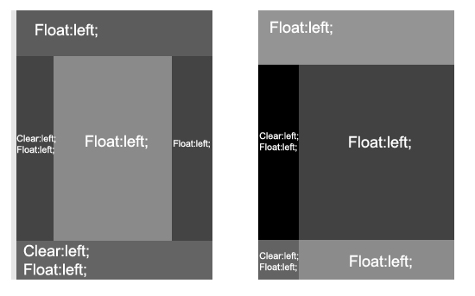
Floating Elements
CSS Positioning Property

Slide 24
Floating Elements
HTML elements can float left and right
float:left
float:right
no floating block
Some text around …
<div style= "float:left">
float:left
</div>
Some text before …
<div style= "margin:0 auto">
no floating block
</div>
Some text around …
<div style= "float:right">
float:left
</div>

Slide 25
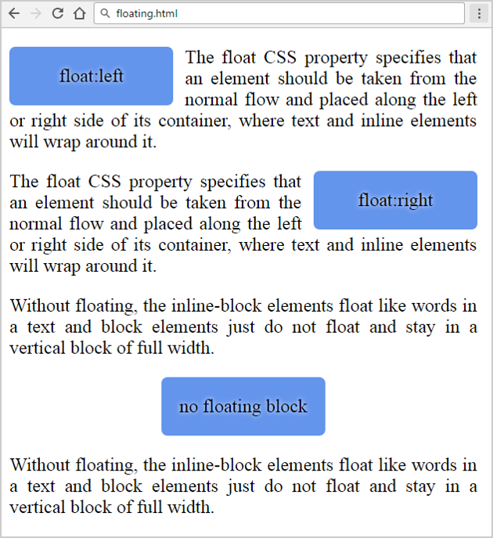
Problem: Floating Elements (HTML)
Create a Web page (HTML + CSS) like at the screenshot:
<main>
<div class="left">left</div>
<p>The float CSS property …</p>
<div class="right">right</div>
<p>The float CSS property …</p>
<p>Without floating …</p>
<div class="center">no float</div>
<p>Without floating …</p>
</main>
Check your solution here: https://judge.softuni.bg/Contests/406/

Slide 26
Solution: Floating Elements (CSS)
main { width: 400px;
text-align: justify; }
.left, .right, .center {
width: 120px; height: 30px;
line-height: 30px;
text-align: center;
padding: 10px;
background: CornflowerBlue;
border-radius: 5px;
text-shadow: 0px 0px 5px white; }
.left {
float: left;
margin-right: 10px;
}
.right {
float: right;
margin-left: 10px;
}
.center {
margin: 0 auto;
}

Slide 27
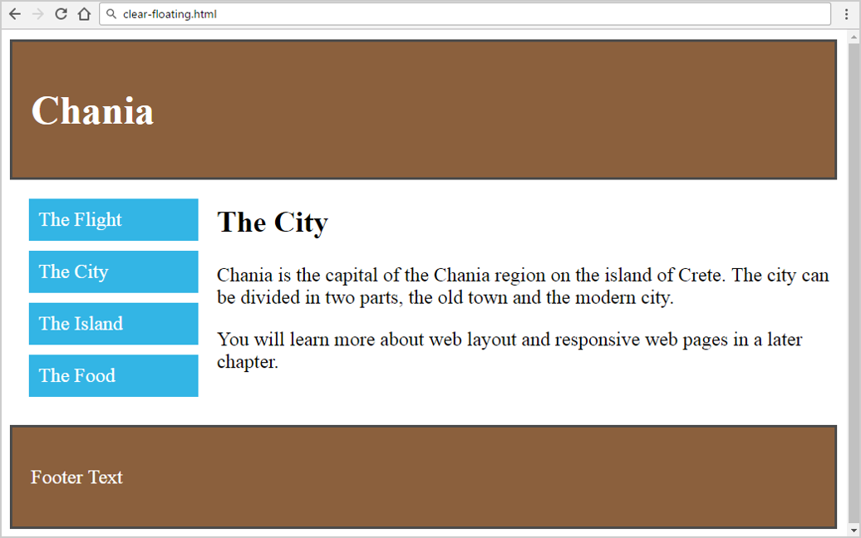
Problem: Clear Floating
You are given the HTML for this page. Write the missing CSS. Use left floating, right floating and clearing

Slide 28
Solution: Clear Floating (HTML)
<header>
<h1>Chania</h1>
</header>
<main class="clearfix">
<aside class="float-left menu">
<ul>
<li>The Flight</li>
<li>The City</li>
<li>The Island</li>
<li>The Food</li>
</ul>
</aside>
Check your solution here: https://judge.softuni.bg/Contests/406/

Slide 29
Solution: Clear Floating (HTML)
<article class="float-right content">
<h2>The City</h2>
<p>Chania is the capital of the Chania…</p>
<p>You will learn more about web layout…</p>
</article>
</main>
<footer>
<p>Footer Text</p>
</footer>

Slide 30
Solution: Clear Floating (CSS)
* { box-sizing: border-box; }
header, footer {
background: #8b603d;
color: white;
padding: 15px;
border: 2px solid #4B4B4B; }
.menu { width: 25%; }
.float-left {
float: left;
padding: 15px; }
.float-right { float: right; }
.content { width: 75%; }
.menu ul {
list-style-type: none;
margin: 0;
padding: 0; }
.menu li {
padding: 8px;
margin-bottom: 8px;
background: #33b5e5;
color: #ffffff; }
.clearfix::after {
content: "";
display: block;
clear: both; height: 0; }

Slide 31
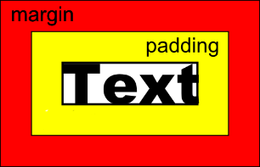

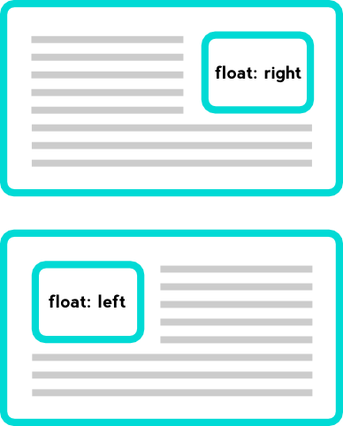
Summary
Margins and Paddings
CSS Positioning
Float and Clear
margin: 5px 0;
padding: 3px 5px 8px 10px;
position: relative;
position: fixed;
position: absolute; …
.left { float: left; }
.clearfix{ clear: left; }

Slide 32







Web Fundamentals – Course Introduction
https://softuni.bg/courses/web-fundamentals-html5

Slide 33






SoftUni Diamond Partners

Slide 34






SoftUni Diamond Partners

Slide 35
License
This course (slides, examples, demos, videos, homework, etc.) is licensed under the "Creative Commons Attribution-NonCommercial-ShareAlike 4.0 International" license

Slide 36





Trainings @ Software University (SoftUni)
Software University – High-Quality Education, Profession and Job for Software Developers
softuni.bg
Software University Foundation
http://softuni.foundation/
Software University @ Facebook
facebook.com/SoftwareUniversity
Software University Forums
forum.softuni.bg

